Slide 1









Infosys Springboard Internship 5.0
Voice Based Patient Call System
Details-
Ritesh G Patil
B3 batch
Mentor-
Ms.Shilpee

Slide 2



Why do we need it?
Current Practice
Traditional patient call systems often lead to delays, missed requests, and poor communication.
Solution
A voice-based patient call system can improve patient engagement and communication, leading to better healthcare outcomes and dynamically prioritizes patient's need with multilingual support.

Slide 3

Objectives
Fast Communication Channel
AI-Powered Prioritization
A robust communication infrastructure for real-time interaction between patients and healthcare providers.
Utilizing AI algorithms to analyze patient data and dynamically prioritize their needs.
Real-time Tracking
and Notifications
Convenience
Enables healthcare providers to monitor patient status and receive timely alerts for critical situations.
Easily adaptable , convenient and accurate

Slide 4
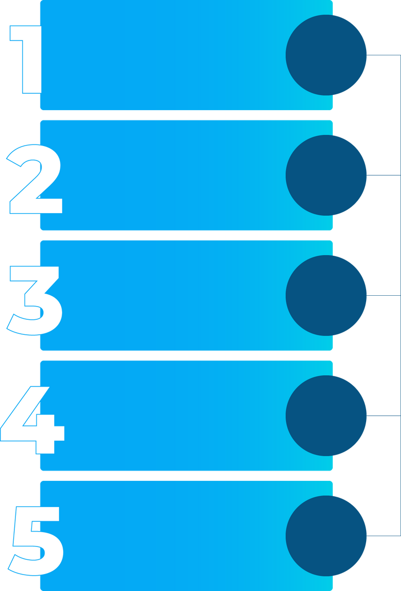





Expo React Native
for Frontend
Node.js and Express
for API
and Server Logic
Technologies
Use
MongoDB for
data Storage
TensorFlow.js
Azure Speech Services

Slide 5
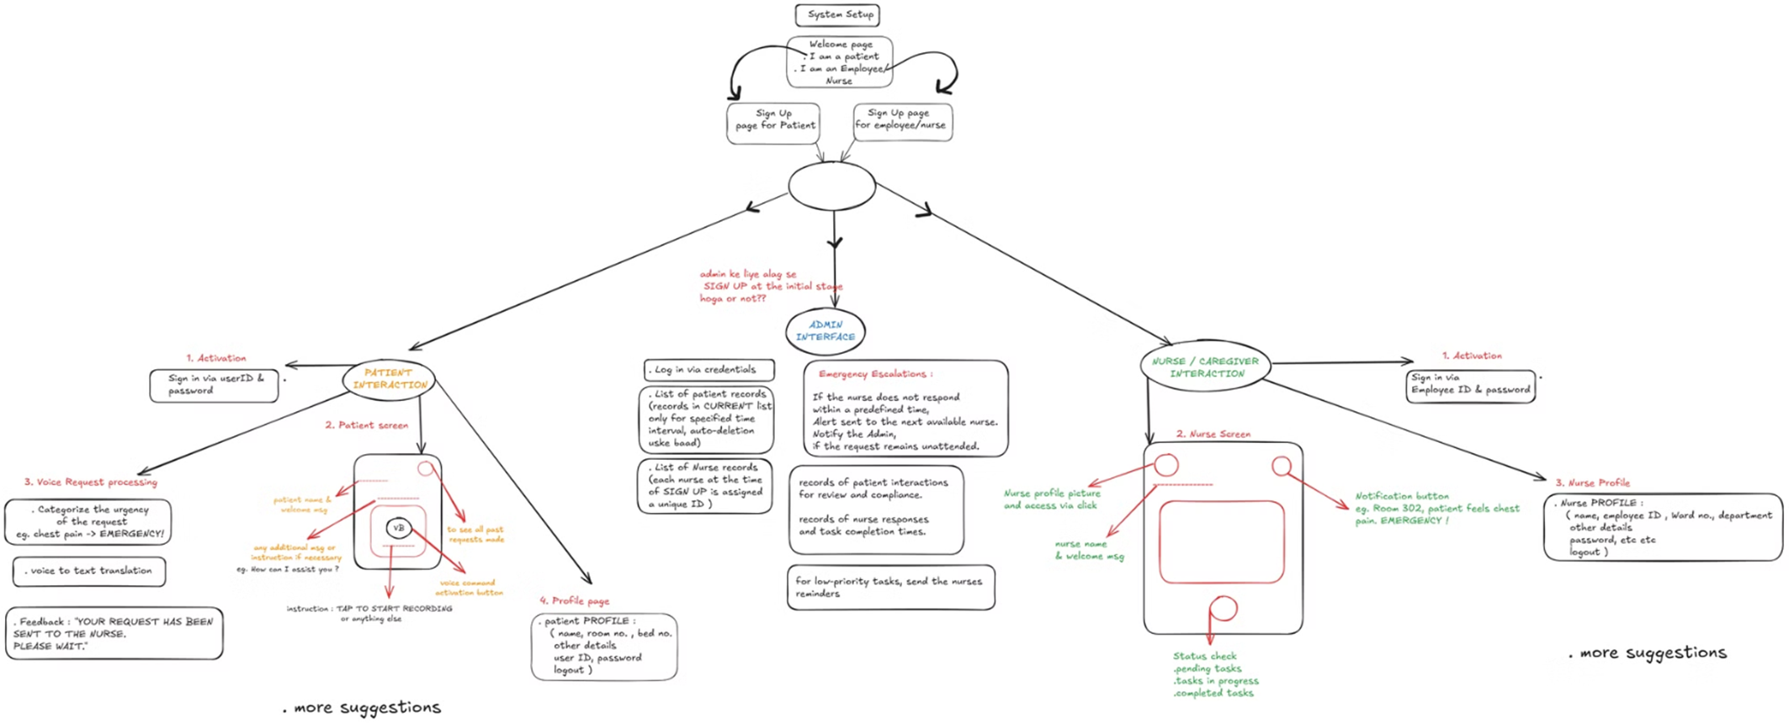
Flowchart

Slide 6
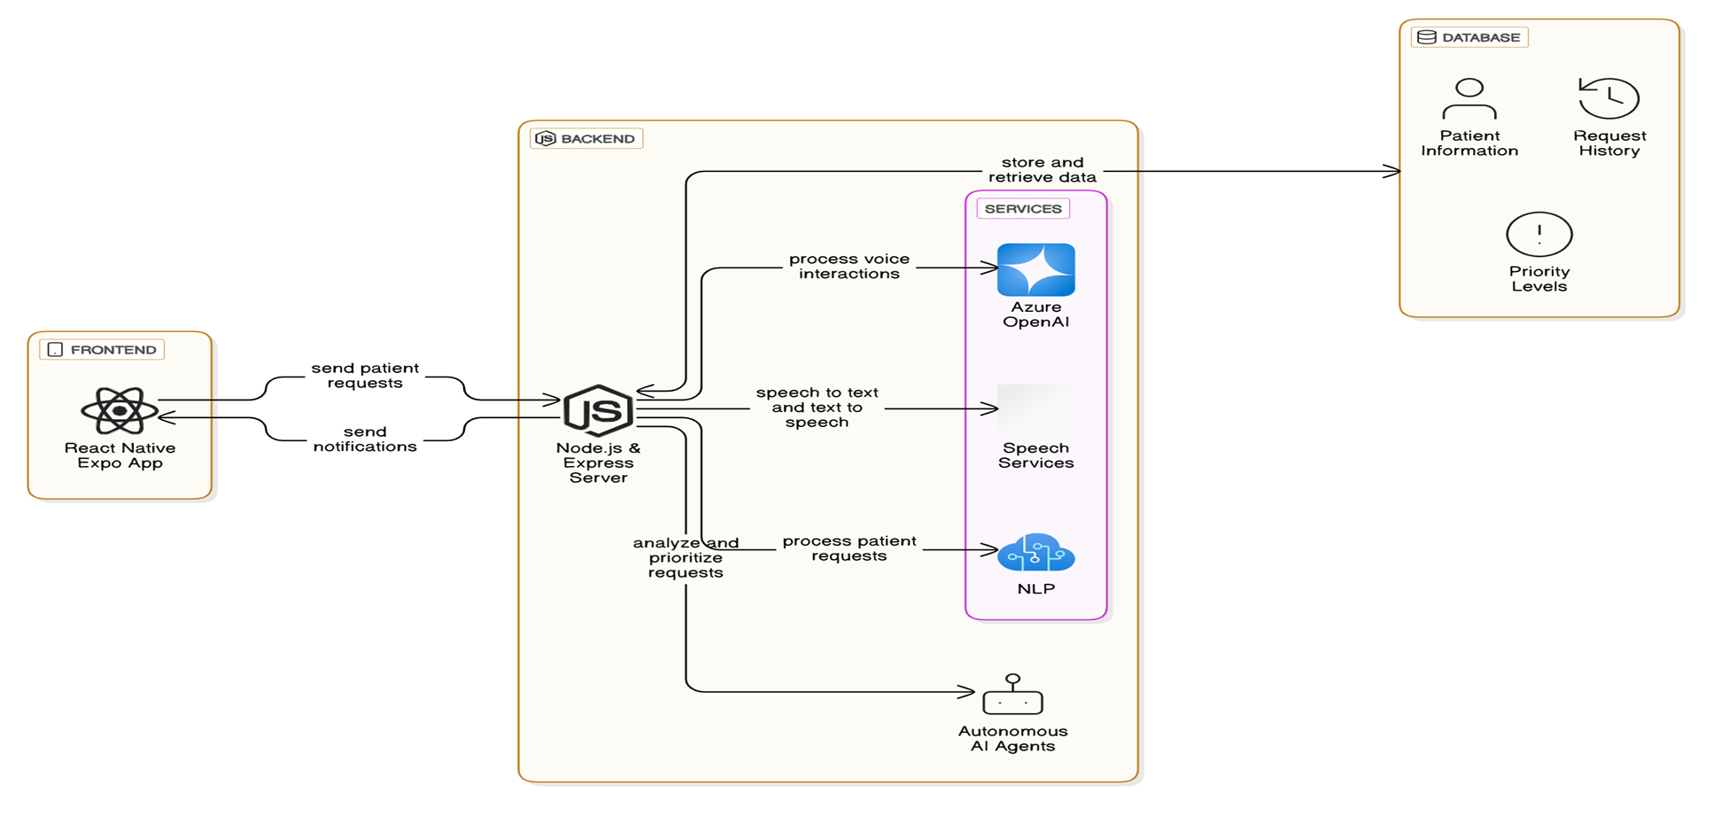
System Diagram

Slide 7

Artificial Intelligence in Healthcare
Autonomous AI Agents
Speech Services Integration
NLP-Powered Request Analysis
Voice-Driven Communication System
Nurse Mobile Application
Improved Patient Care

Slide 8
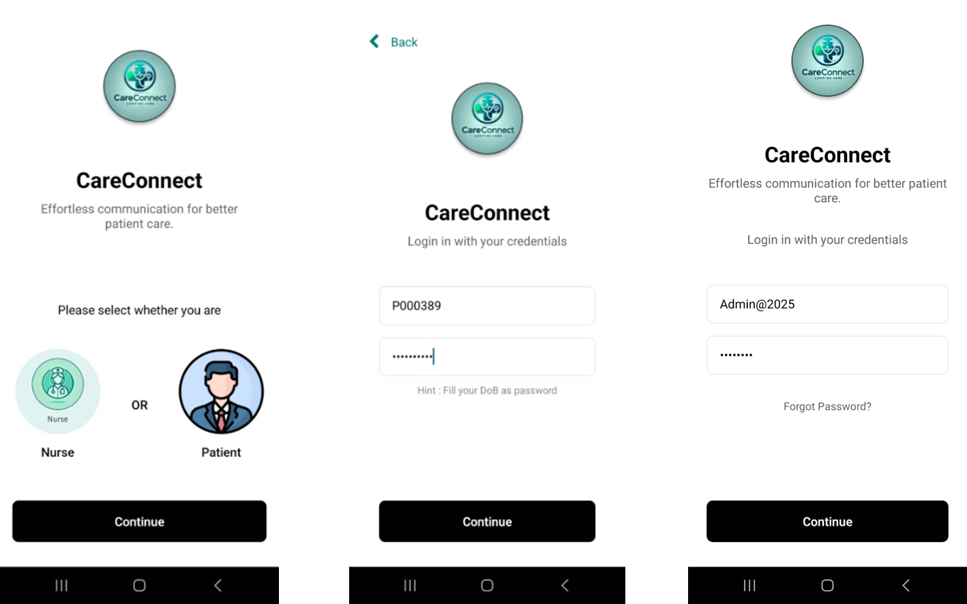
App Interface

Slide 9
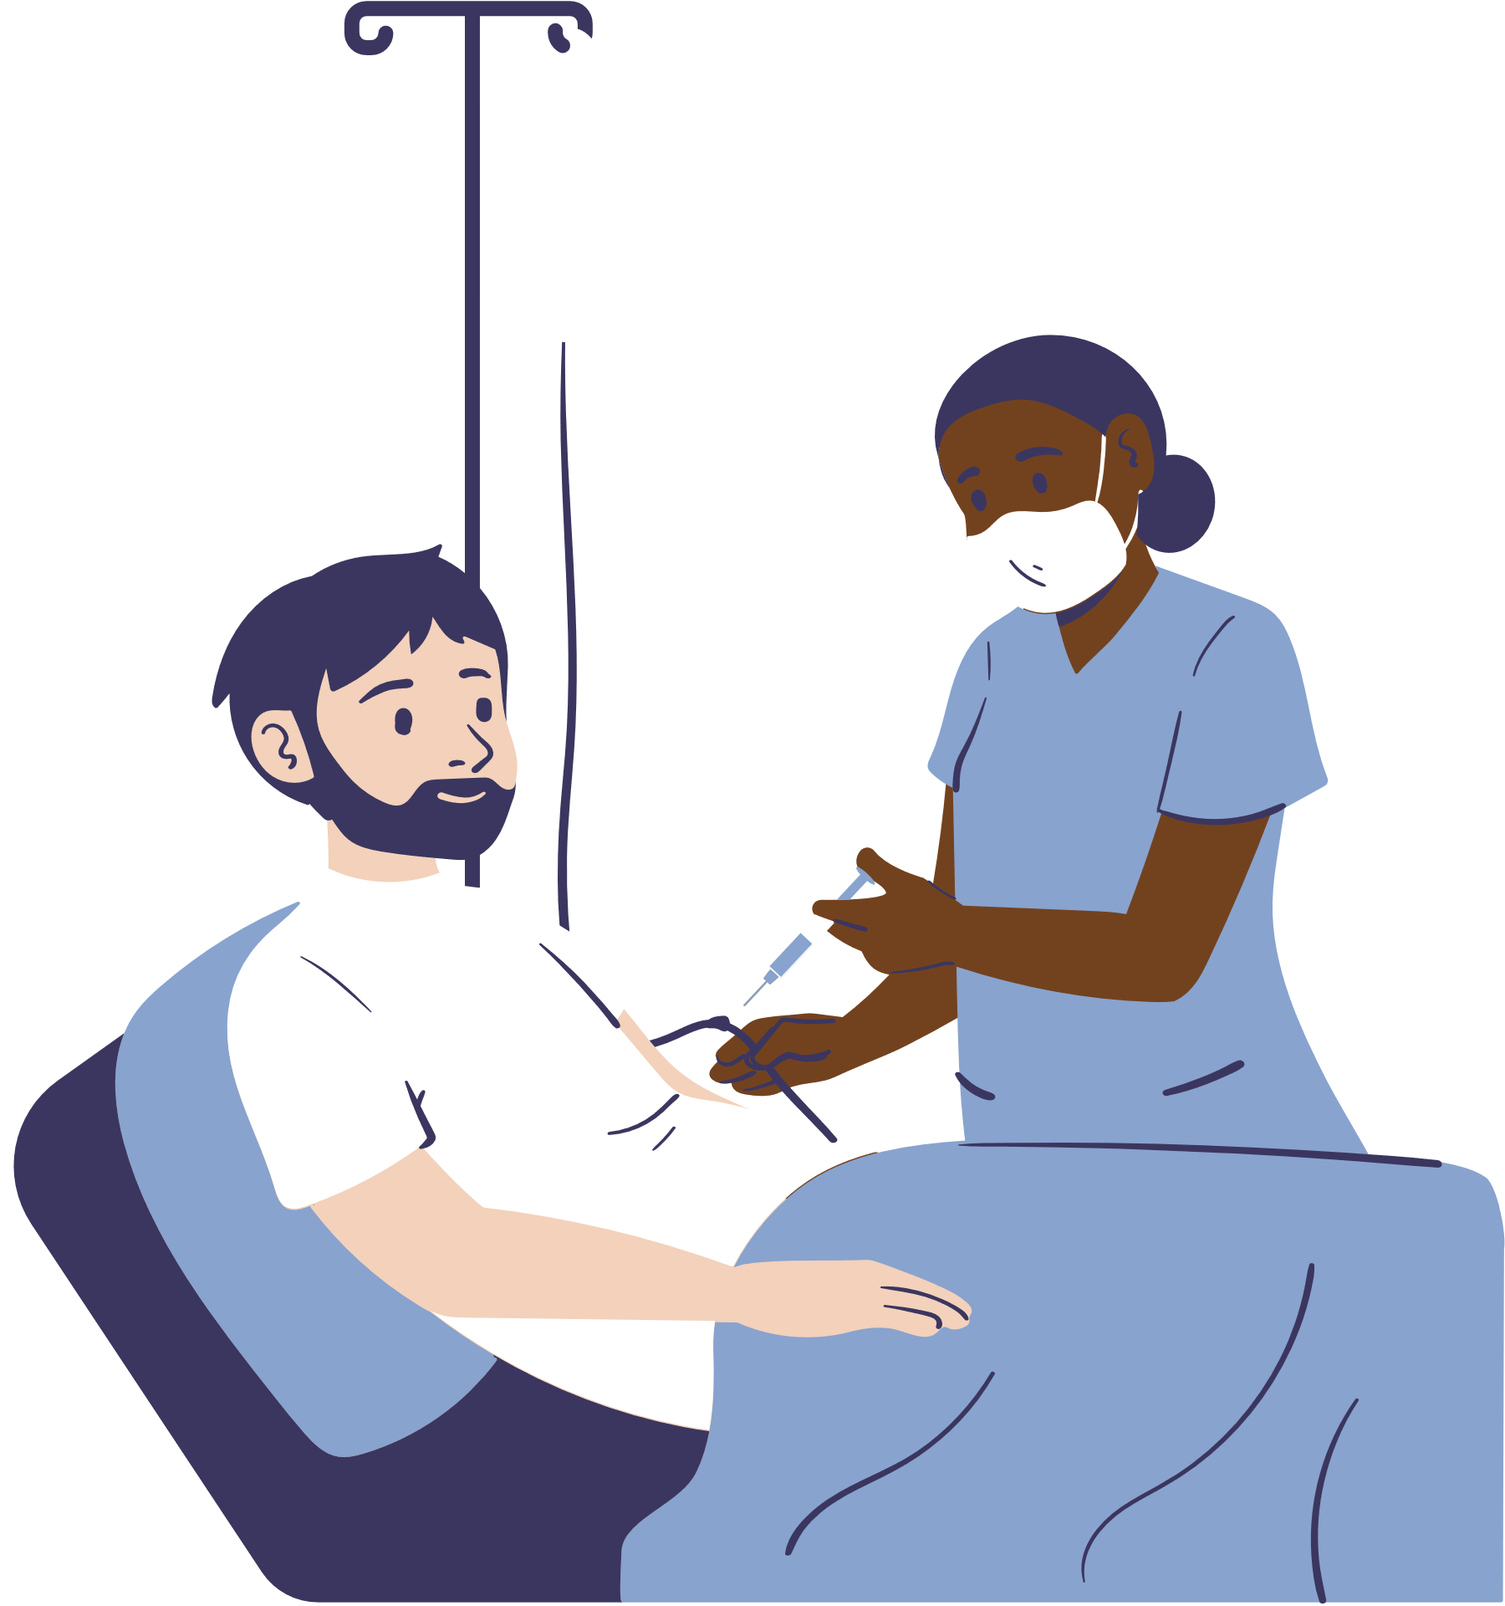
Key Features
Personalized Patient Experience
The system tailors interactions to each patient's needs.
Conversational AI Interface
The system uses a natural language processing (NLP) engine to understand and respond to patient queries in a conversational manner.
Request-Prioritization
AI classifies the requests as High, medium, low.
Real-time Updates and Notifications
Healthcare Staff receive notifications as soon as the request has been made by the Patient.

Slide 10
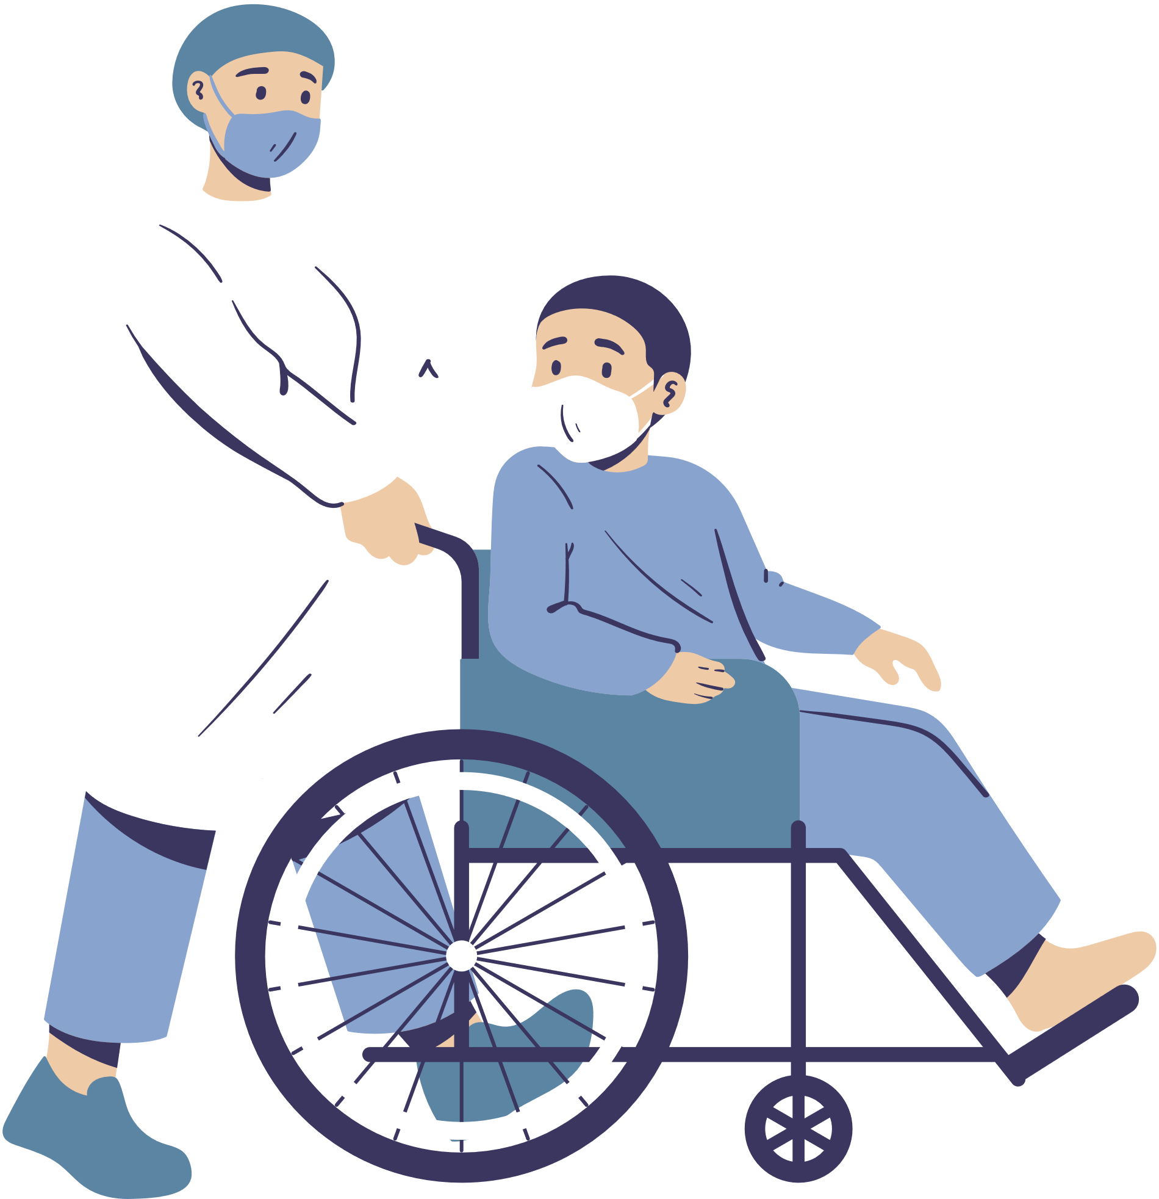


Integration with
Wearables
Predictive Analytics
Future
Scope and
Roadmap
Virtual Assistant for
Chronic Conditions
IOT Devices Integration

Slide 11

Thank you for your attention

